Slide 1
PRE-FLOOD ARRANGEMENTS (2017)
A. Cabinet Committee on Floods have conducted seven meetings
  1st Cabinet Committee Meeting (06.04.2017)
  2nd Cabinet Committee Meeting (07.04.2017)
  3rd Cabinet Committee Meeting (13.04.2017)
  4th Cabinet Committee Meeting (19.04.2017)
  5th Cabinet Committee Meeting (27.04.2017)
  6th Cabinet Committee Meeting (09.05.2017)
  7th Cabinet Committee Meeting (01.06.2017)
  8th Cabinet Committee Meeting (14.06.2017)
  9th Cabinet Committee Meeting (21.06.2017)

Slide 2
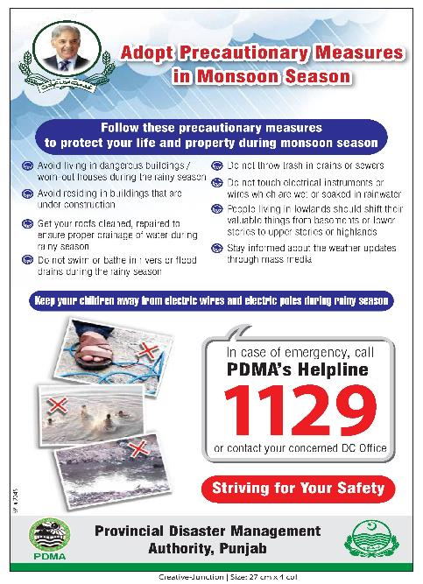
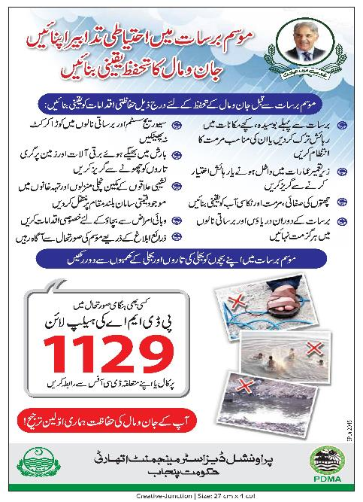
Print Media

